Slide 1

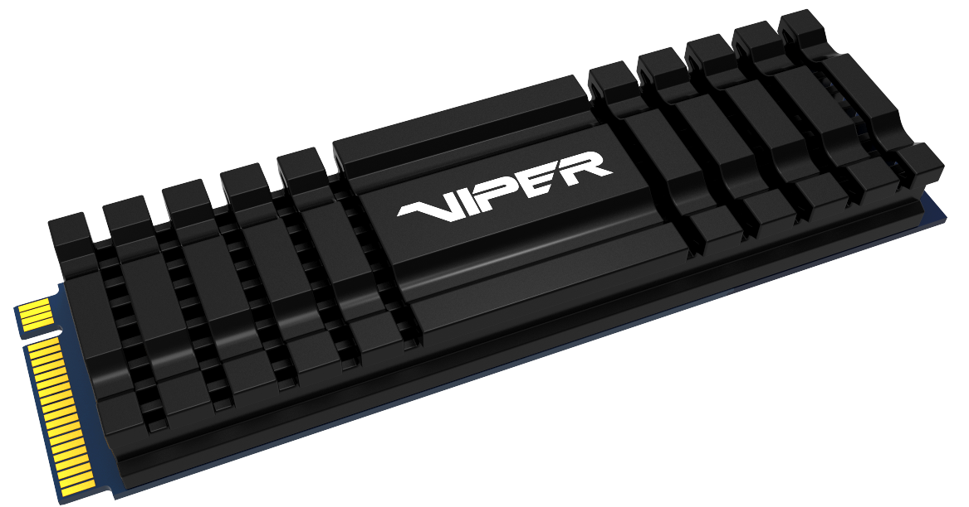
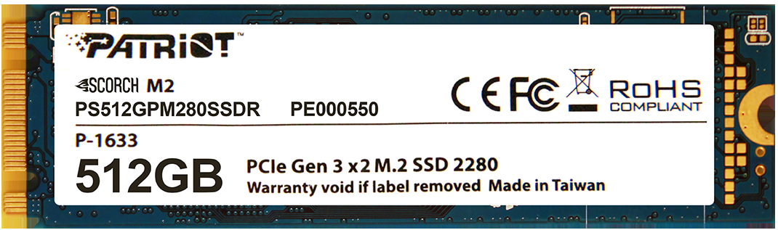

VIPER VPN100 vs. Scorch M.2 SSDs
Comparison of SSD’s specs and features
www.patriotmemory.com
04.04.2019

Slide 2
VPN100 & Scorch comparison
The VPN 100 is a high performance PCIe 3X4, NVMe 1.3, m.2 SSD geared primarily for high end applications like content creation, video editing, and gaming. The VPN 100 comes standard with an aluminum heat spreader and external thermal sensor to help manage the heat build up and prolong the life of the drive. The VPN100 is designed for desktop PC’s. Note: Due to the functional heat spreader, it will not fit in laptop PCs.
The Scorch PCIe 3x2, NVMe 1.2, m.2 SSD is an excellent choice for mainstream computer applications. Though not as fast as the VPN100 series, the Scorch ensures quicker boot up, faster load times, and high endurance compared to standard hard disk drives and 2.5” SATA3 SSDs. The Scorch will fit in both laptops and desktop PCs.
PRODUCT DESCRIPTION
CAPACITY | INTERFACE/PROTOCOL | CONTROLLER | FORM FACTOR | DRAM CACHE | PERFORMANCE SEGMENT
VPN100
VPN100-2TBM28H | 2TB | PCIe Gen 3x4, NVMe 1.3 | Phison E12 | M.2 2280 | 2GB | High
VPN100-1TBM28H | 1TB | PCIe Gen 3x4, NVMe 1.3 | Phison E12 | M.2 2280 | 1GB | High
VPN100-512GM28H | 512GB | PCIe Gen 3x4, NVMe 1.3 | Phison E12 | M.2 2280 | 512MB | High
VPN100-256GM28H | 256GB | PCIe Gen 3x4, NVMe 1.3 | Phison E12 | M.2 2280 | 512MB | High
SCORCH
PS512GPM280SSDR | 512GB | PCIe Gen 3x2, NVMe 1.2 | Phison E8 | M.2 2280 | 512MB | Standard
PS256GPM280SSDR | 256GB | PCIe Gen 3x2, NVMe 1.2 | Phison E8 | M.2 2280 | 256MB | Standard
PS128GPM280SSDR | 128GB | PCIe Gen 3x2, NVMe 1.2 | Phison E8 | M.2 2280 | 256MB | Standard

Slide 3
Performance, Endurance, Power
PERFORMANCE, ENDURANCE &POWER
SEQ READ | SEQ WRITE | 4K RANDOM READ | TBW | PEAK | IDLE
VPN100
VPN100-2TBM28H | 3300MB/s | 3100MB/s | 700K | 3115 TB | up to 7W | up to 2W
VPN100-1TBM28H | 3450MB/s | 3000MB/s | 700K | 1665 TB | up to 7W | up to 2W
VPN100-512GM28H | 3300MB/s | 2200MB/s | 700K | 800 TB | up to 7W | up to 2W
VPN100-256GM28H | 3000MB/s | 1000MB/s | 300K | 380 TB | up to 7W | up to 2W
Scorch
PS512GPM280SSDR | 1700MB/s | 950MB/s | 200K | 300 TB | up to 4.2W | up to 40mW
PS256GPM280SSDR | 1700MB/s | 780MB/s | 200K | 150 TB | up to 3.6W | up to 35mW
PS128GPM280SSDR | 1700MB/s | 415MB/s | 200K | 75 TB | up to 2.6W | up to 35mW

Slide 4
Advanced Hardware and Firmware Features
ADVANCED FEATURES
HEAT SPREADER | EXTERNAL THERMAL SENSOR | ADVANCED WEAR LEVELING | BAD BLOCK MANAGEMENT | TRIM SUPPORT | SMART | OVER PROVISIONING | END-TO-END DATAPATH PROTECTION | SMART REFRESH | SMART ECC | WINDOWS 7*/8.0*/8.1/10
Viper VPN100
VPN100-2TBM28H |  |  |  |  |  |  |  |  |  |  | 
VPN100-1TBM28H |  |  |  |  |  |  |  |  |  |  | 
VPN100-512GM28H |  |  |  |  |  |  |  |  |  |  | 
VPN100-256GM28H |  |  |  |  |  |  |  |  |  |  | 
Scorch
PS512GPM280SSDR |  |  |  |  |  |  |  |  |  |  | 
PS256GPM280SSDR |  |  |  |  |  |  |  |  |  |  | 
PS128GPM280SSDR |  |  |  |  |  |  |  |  |  |  | 

Slide 5
Thank you

