Slide 1
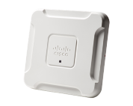
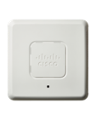
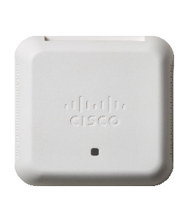
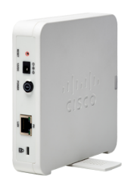
Cisco SMB WAP
Wireless AC + N Models
WAP361
500 Series
14x Series
wireless mesh extenders
300 Series
200 Series
100 Series
WAP581
802.11 AC Wave2
Dual LAN interfaces
(2.5G and GigE), Up to 2.8 Gbps throughput
Business Class (Simplicity & Affordability) Controller-less
WAP571
WAP571E
Dual GigE Uplinks, RF Spectrum Analyzer, Smart POE, Up to
1900 Mbps Throughput,
IP66-rated Outdoor Form Factor (571E)
WAP150
Desktop AP
Dual Radio
Up to 1200 Mbps Throughput
CB240
Wall Plate form factor, 2 GigE SWitch Ports
Up to 1773 Mbps Throughput
Captive Portal
WAP125
Dual Radio
Up to 867 Mbps
Captive Portal
CB145
Dual Radio
Up to 867 Mbps
2x2MU MIMO
CB140
Dual Radio
Up to 867 Mbps
2x2MU MIMO
CB140,141,142 mesh extender
Dual Radio
Up to 867 Mbps
2x2MU MIMO
Good, Better, Best in Capabilities & Performance
Notes:
Jaky switch vyuziva Mgbit technologii? U WiFi máme řady 100, 300 a 500 s rychlostmi N a AC

Slide 2
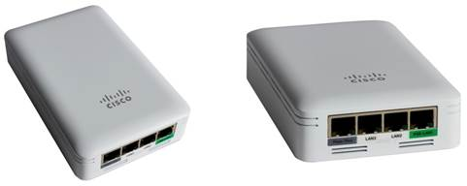
What’s New: Cisco Business Wireless
Cisco Business
140 Series
(CBW140AC-x )
Cisco Business
145 Series (CBW145AC-x)
Cisco Business
240 Series (CBW240AC-x )
Purpose-Built
High Performance
High Performance
802.11ac Wave 2
300 + 867 Mbps / 2,4 + 5 GHz
2 x 2:2 SU / MU-MIMO
1 x GE ports
Napájení PoE
400 clients – 2,4 + 5 GHz
WPA 2, 3
Dynamický výběr frekvence
1 GB DRAM
čtyřjádrový procesor
802.11ac Wave 2
300 + 867 Mbps / 2,4 + 5 GHz
2 x 2:2 SU / MU-MIMO
3 x GE ports, 1 x PoE ( GE uplink )
Napájení PoE
400 clients – 2,4 + 5 GHz
WPA 2, 3
Dynamický výběr frekvence
1 GB DRAM
čtyřjádrový procesor
802.11ac Wave 2
600 + 1 773 Mbps / 2,4 + 5 GHz
4 x 4:4 MU-MIMO
2 x GE ports, 1 x PoE
Napájení PoE
400 clients – 2,4 + 5 GHz
WPA 2, 3
Dynamický výběr frekvence
1 GB DRAM
čtyřjádrový procesor

Slide 3
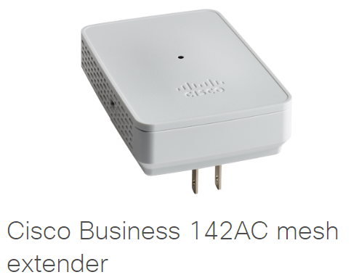
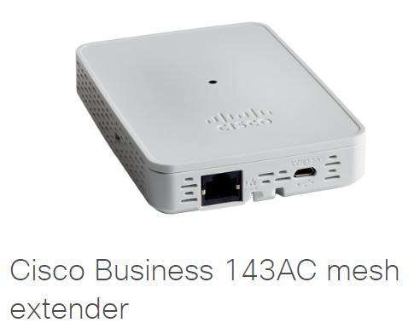
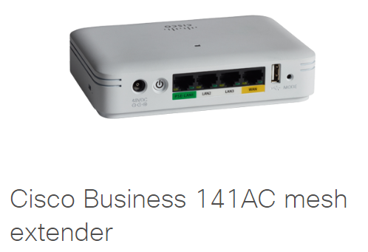
0 x GE ports
1 x GE ports
4 x GE ports
Purpose-Built
High Performance
High Performance
802.11ac Wave 2
144 + 867 Mbps / 2,4 + 5 GHz
2 x 2 MU-MIMO
0 - 4 x GE ports
1 x GE uplink + 1 x PoE 15,4 W + 2 x GE
Napájení PoE
400 clients – 2,4 + 5 GHz
WPA 2, 3
Dynamický výběr frekvence
1 GB DRAM
čtyřjádrový procesor

