Slide 1
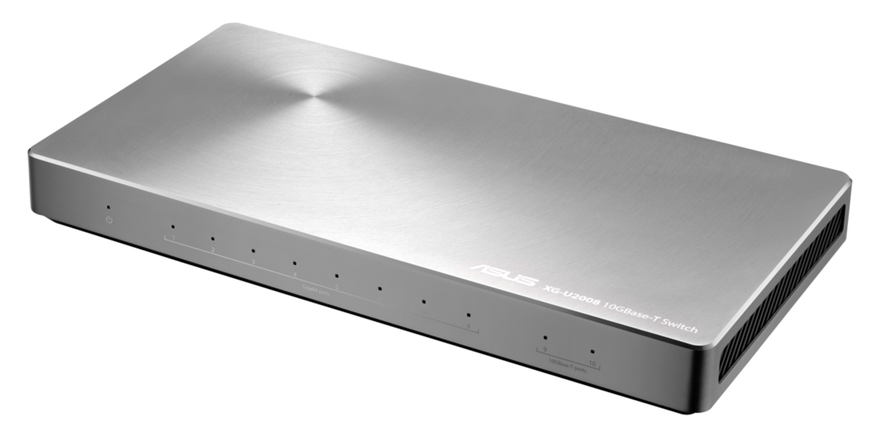
ASUS XG-U2008 10G Unmanaged Switch
Networking & Wireless Business Unit ASUSTek Computer
Date: 2016/9/1
For ASUS internal use only. Do not distribute without authorization.

Slide 2
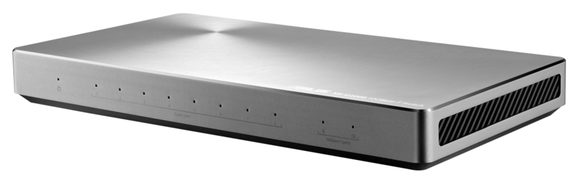
Marketing initiative brief
Target Segment:
High (Designer / SMB / ROG (LAN party) / SOHO )
Key Selling Points
Extremely fast 10GBase-T
Plug & Play (Easy to use)
Slim and stylish Design
Accessories
Power Adapter (12V/1.5A)
QSG
Warranty Card
Rack-mount bracket (Optional)
MSRP: US$ 249
For ASUS internal use only. Do not distribute without authorization.

Slide 3
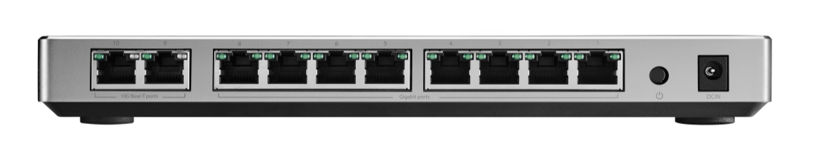
XG-U2008
ASUS XG-U2008 is the first 10GBase-T switch which design for pro-user. With two 10GBase-T RJ45 ports, user can easy to reach the next stage with their Cat6 or upper level cable. XG-U2008 also has the other eight ports for 1G (also suit for 100 Mbps) that user can easy to build a LAN party with fully 1G speed for each device.
Using XG-U2008, the users just go plug and play. It is no need to do other setting before or while using.
With slim and stylish appearance, XG-U2008 just jumps out of the box for the traditional 10GBase-T switch design. However, for some SMB users, it also has the optional rack-mount bracket for extend.
So, let reach the top with XG-U2008!
For ASUS internal use only. Do not distribute without authorization.

Slide 4
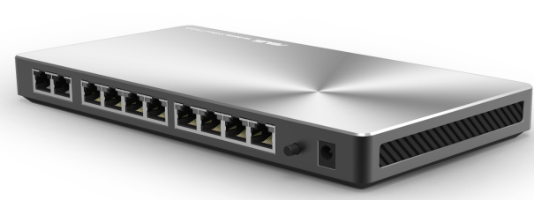

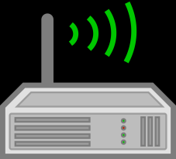




Extremely fast 10GBase-T
10GBase-T
ASUS XG-U2008 is the first 10GBase-T switch which design for pro-user. With 10GBase-T, XG-U2008 is a cost effective 10 GbE switch for user to upgrade to next stage with Cat5 or upper cable.
RJ-45 port for 2 x 10G
RJ-45 port for 8 x 1G
Router
FTP Server
NAS
Desktop PC
NB
For ASUS internal use only. Do not distribute without authorization.

Slide 5
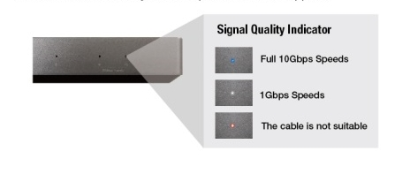
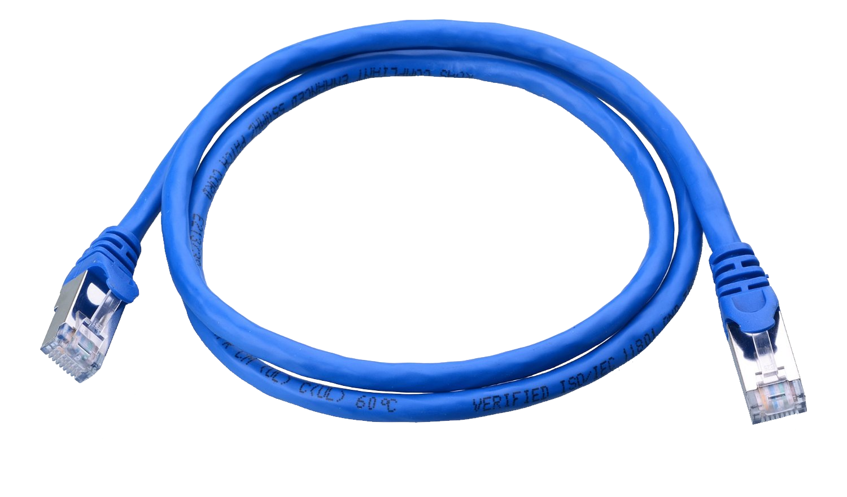
Plug & Play (Easy to use)
Enjoy true plug-and-play convenience, with absolutely no setup required! Each port automatically configures itself depending on the type of device you connect.
The cable is not good signal
The Cable is one of the key element for data transmit in 10G speed. Once the cable is not in well status, the front and back LED will show amber light which helps user to recognize that “This cable is not good for 10G-BaseT access”.
For ASUS internal use only. Do not distribute without authorization.

Slide 6
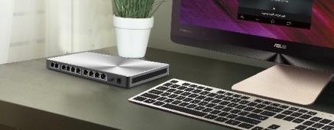
Fast and stable connection for each device
The fan-less design eliminates noise, which helps maintain a peaceful environment, the great performance with up to 10G speed provide a cost-effective connection for small-to-medium enterprises and power users.
Slim and stylish Design
With its attractive design, spun-metal finish and tough all-metal construction, there’s no need to keep XG-U2008 hidden out of sight! Its slim and compact shape makes it easy to locate anywhere, and it’s built for durability in any office, studio or home environment.
Dimensions (L x W x H): 240mm x 125mm x 27mm
For ASUS internal use only. Do not distribute without authorization.

Slide 7
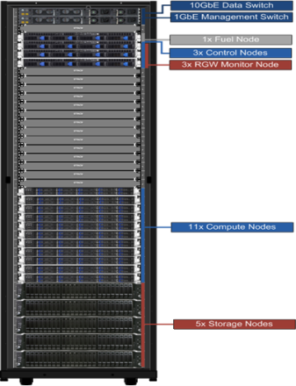
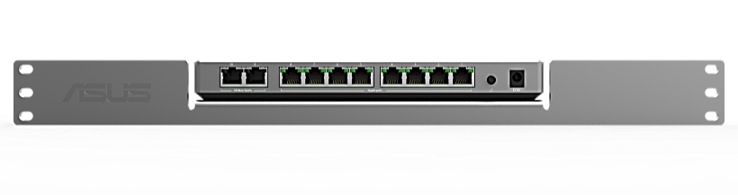
Rack mountable (Optional)
19" Rack-mountable Placement:
Easy to mount your switch on a 19'' rack saves your space around the office.
For ASUS internal use only. Do not distribute without authorization.

Slide 8

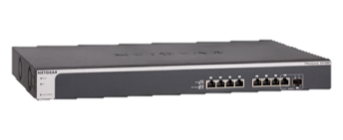
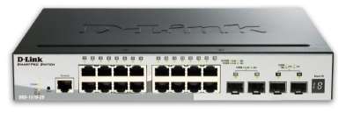
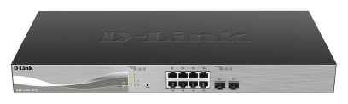
Comparison Table
Model Name | XG-U2008 | XS708E | DGS-1510-20 | DXS-1100-10TS
Picture
Interface | 2 x 10GBASE-T ports 8 x 100/1000 Mbps RJ45 ports | 8 x 10GBASE-T ports 1 x SFP+ combo port supporting 10G | 2 x 10G SFP+ ports 2 x 1G SFP ports 16 x 10/100/1000 BASE-T Ports | 8 x 10GBASE-T ports 2 x 10G SFP+ ports
Type | Unmanaged Switch | Web Smart Switch (ProSAFE® Plus Switch) | Smart Managed Switch | Smart Managed Switch
Dimensions (w x d x h) | 240 x 125 x 27mm 9.45 x 4.92 x 1.06 inches 0.6 Kg | 440 x 257 x 43 mm 17.3 x 10.11 x 1.7 inches 3.6 Kg | 280 x 180 x 44 mm 11 x 7.09 x 1.73 inches 1.24 kg | 440 x 210 x 44 mm 17.36 x 1.73 x 8.27 inches 2.69 kg
Price | US$249~299 | US$849.99 | US$329.99 | US$855.14
For ASUS internal use only. Do not distribute without authorization.

Slide 9
Specification
Network Interface | RJ-45 for 10GBase-T, 1000Base-T, 100Base-TX
Ports | 10 ports (8 RJ45 ports * 1G, 2 RJ45 ports * 10G)
Cable (For reference) | 10GBase-T: Cat6A, & Cat6 or better 1000Base-T: Cat5, Cat5e, Cat6, or better. 100Base-TX: Cat5, Cat5e or better. *For 10GBase-T, Cat6A and Cat6 will have limitation for 10G transfer. Cat6 is no longer than 55m and Cat6A is no longer than 100m.
AC Power | 100-240 VAC 50-60 Hz, 1.5 A max.
Power Consumption | 33W max
Operation Temperature | 0-40°C (32~104°F)
Operation Humidity | 10%~90% relative humidity, noncondensing
Dimensions (L x W x H) | 240mm x 125mm x 27mm
For ASUS internal use only. Do not distribute without authorization.

